Slide 1

Image Captioning using convolutional and sequential models
By Jayanth Nadakuduru
001525651
Special Topics in Artificial Intelligence Final project

Slide 2
Outline
Problem Statement
Recommended solution
Data set
Analysis of the Data set
Recommended approach and architecture
Implementations
Results
Performance evaluation
Conclusion and future directions
References
Related Work

Slide 3
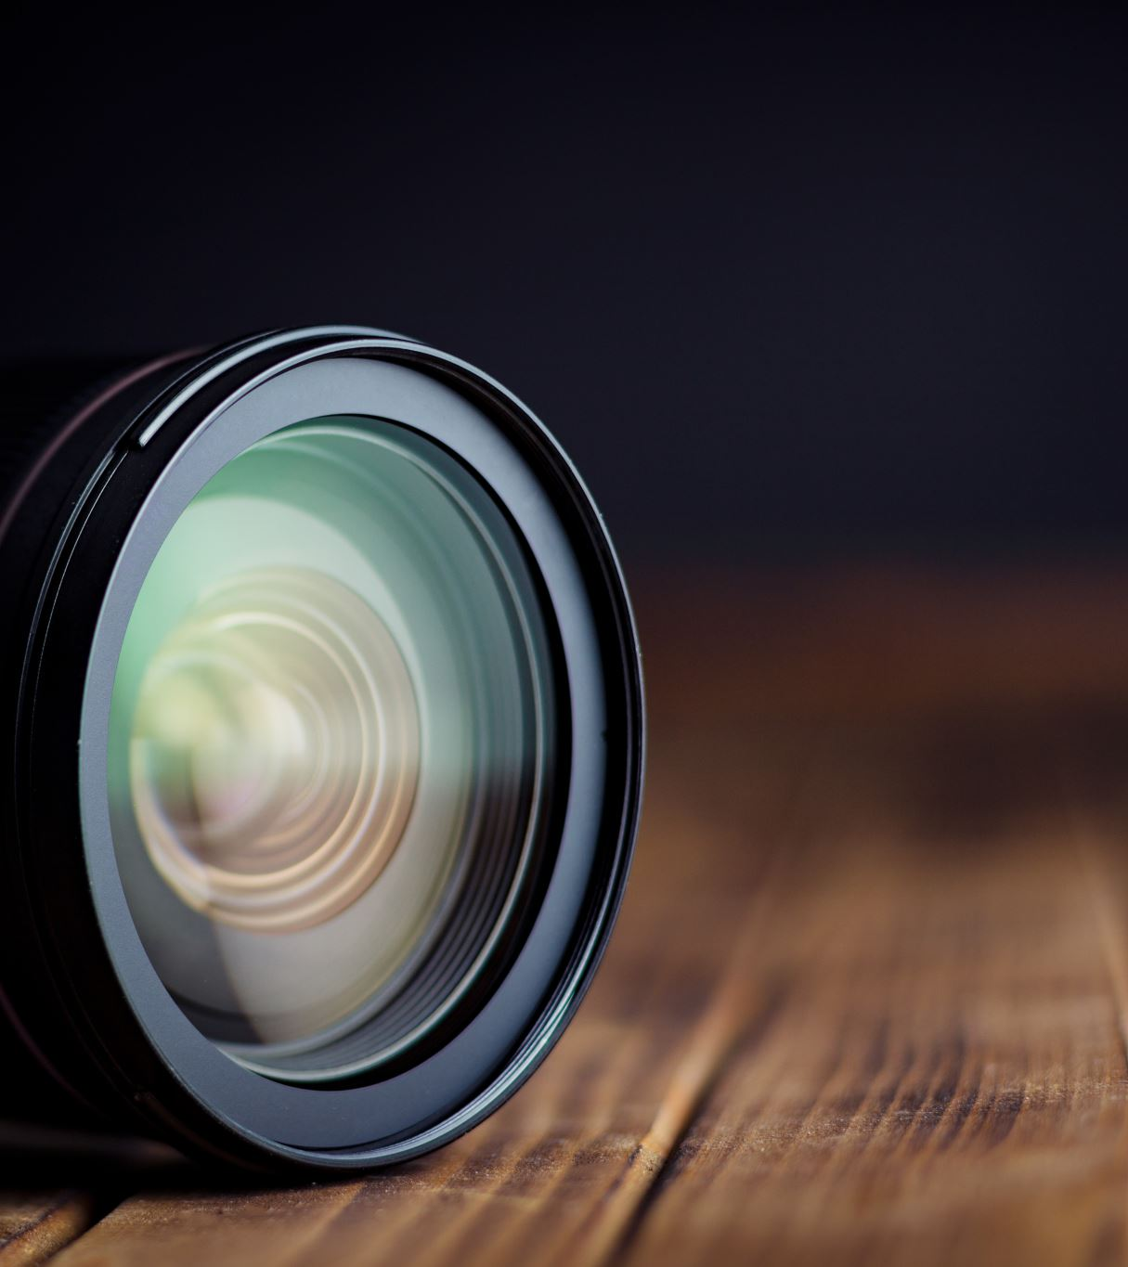
Problem statement
To develop a Deep learning model that can automatically describe photographs or images
Caption generation is a challenging artificial intelligence problem where a textual description must be generated for a given photograph.

Slide 4
Approach to solve the problem
We will tackle this problem using an Encoder-Decoder model. Here our encoder model will combine both the encoded form of the image and the encoded form of the text caption and feed to the decoder.
Our model will treat CNN as the ‘image model’ and the RNN/LSTM as the ‘language model’ to encode the text sequences of varying length. The vectors resulting from both the encodings are then merged and processed by a Dense layer to make a final prediction.
To encode our image features we will make use of transfer learning. There are a lot of models that we can use like VGG-16, InceptionV3, ResNet

Slide 5
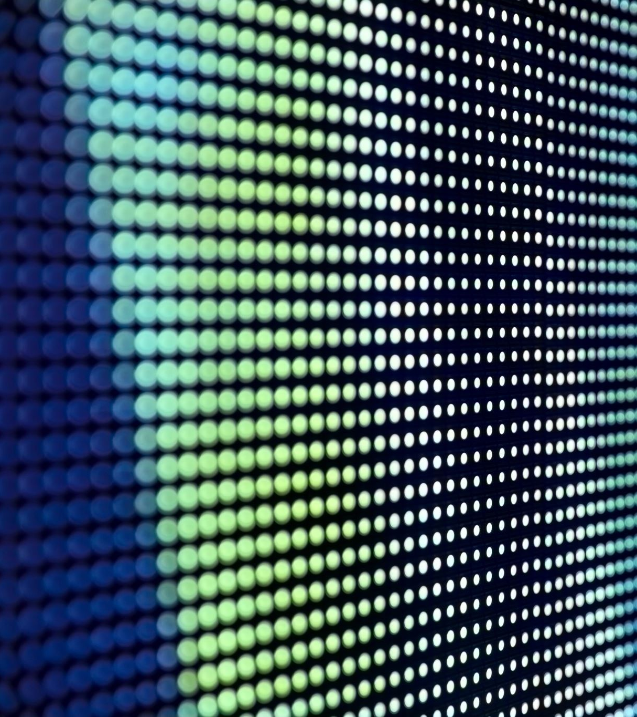
Dataset
We will be using the Flickr 8k dataset
In the Flickr8k dataset, each image is associated with five different captions that describe the entities and events depicted in the image that were collected
Our dataset structure is as follows:-
Flick8k/
Flick8k_Dataset/ :- contains the 8000 images
Flick8k_Text/
Flickr8k.token.txt:- contains the image id along with the 5 captions
Flickr8k.trainImages.txt:- contains the training image id’s
Flickr8k.testImages.txt:- contains the test image id’s

Slide 6
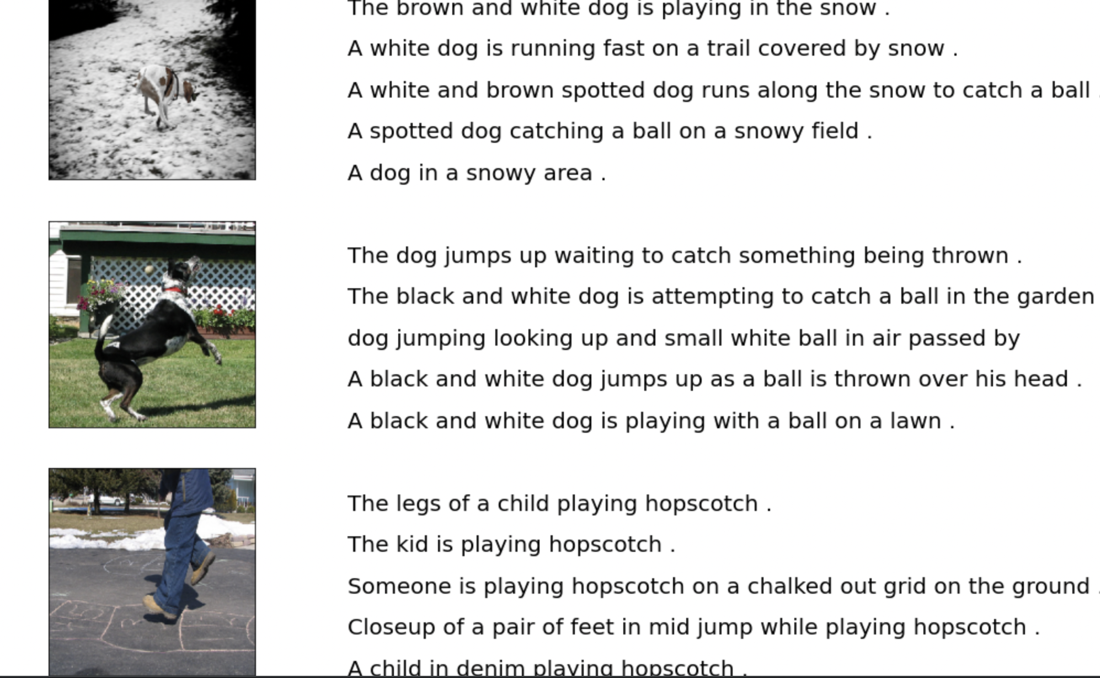
Sample of the Data

Slide 7
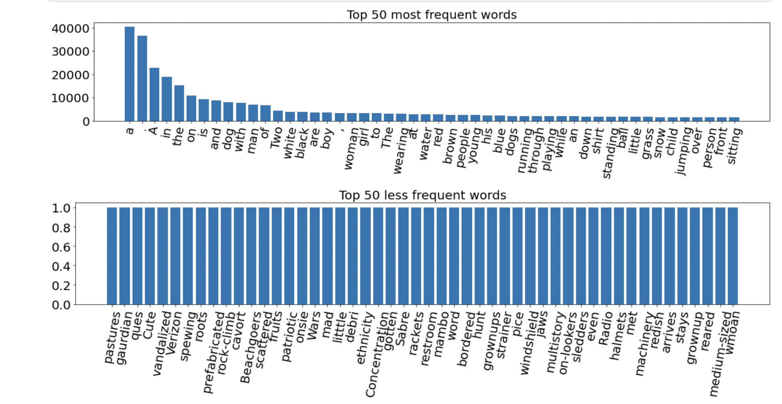
Understanding the text

Slide 8
Technical approach and architecture
Prepare Photo Data . We can pre-compute the “image features” using the pre-trained model and save them to file. We can then load these features later and feed them into our model
Develop a deep learning model
We will describe the model in three parts:
Photo Feature Extractor
Sequence Processor
Decoder

Slide 9
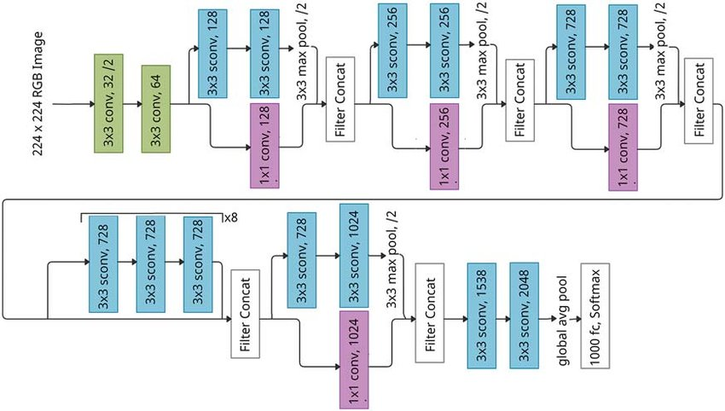
XceptionNet

Slide 10
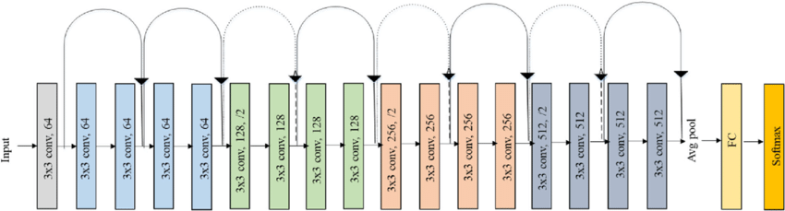
Resnet Architecture
This is the architecture for resnet
Architecture for resnet 152 has 152 layers that are connected, with skip connections every 3 layers

Slide 11
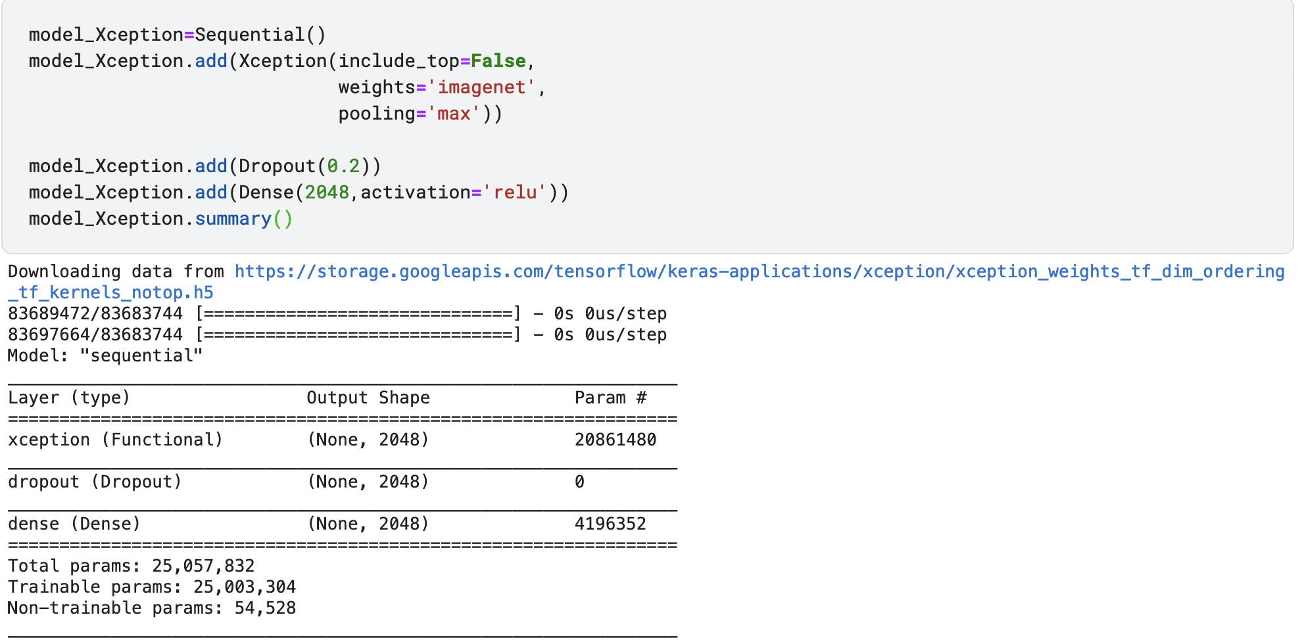
Implementation

Slide 12
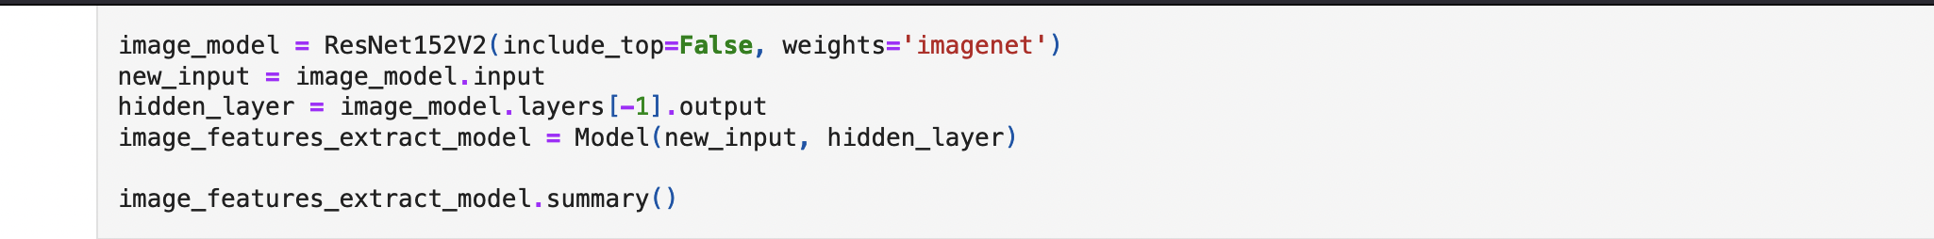
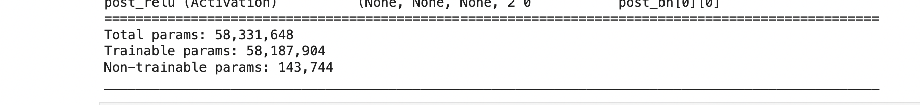
Implementation of Resnet traditional

Slide 13
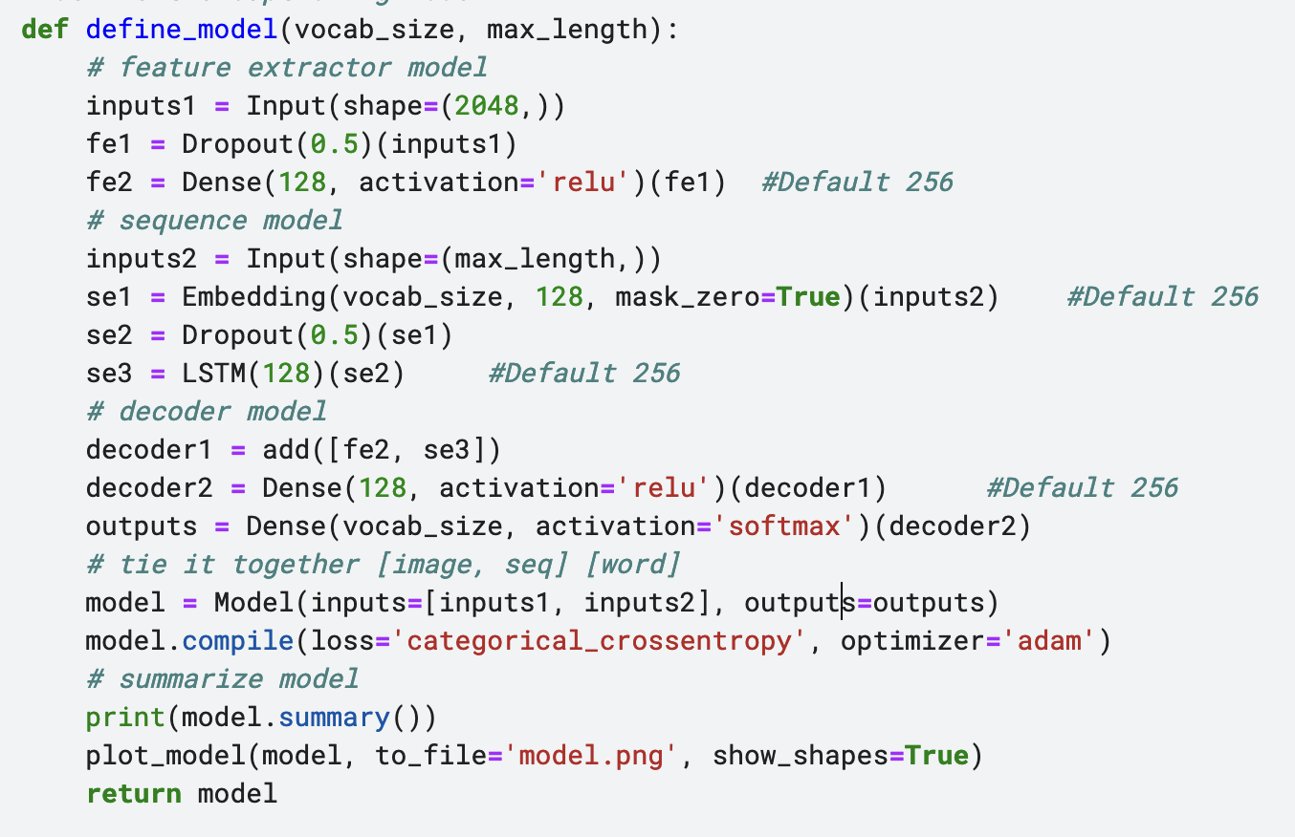
Sequence model

Slide 14
Models
Models implemented include
Xception net + LSTM
Resnet 152 + LSTM
Resnet 152 + GRU
Models are evaluated based on the BLEU score

Slide 15
Evaluation of the model
Once the model is fit, we can evaluate the skill of its predictions on the holdout test dataset.
We will evaluate a model by generating descriptions for all photos in the test dataset and evaluating those predictions with a standard cost function.
The function below named evaluate_model() will evaluate a trained model against a given dataset of photo descriptions and photo features. The actual and predicted descriptions are collected and evaluated collectively using the corpus BLEU score that summarizes how close the generated text is to the expected text.

Slide 16
Bleu
BLEU scores are used in text translation for evaluating translated text against one or more reference translations.
Here, we compare each generated description against all of the reference descriptions for the photograph. We then calculate BLEU scores for 1, 2, 3 and 4 cumulative n-grams
The weights are specified as a tuple where each index refers to the gram order. To calculate the BLEU score only for 1-gram matches, you can specify a weight of 1 for 1-gram and 0 for 2, 3 and 4 (1, 0, 0, 0).

Slide 17
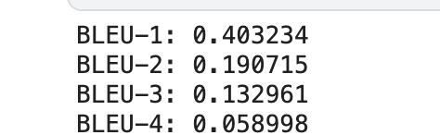
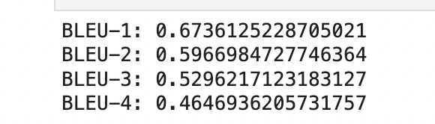
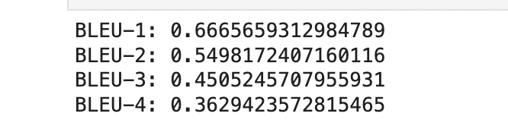
results
Xception net + LSTM
Resnet 152 + LSTM
Resnet 152 + GRU

Slide 18
Conclusion and future direction
We can see that Resnet model with Imagenet weights performed way better and can be improved.
Using a larger dataset and training the model for more epochs would could increase the models bleu score

Slide 19
References
https://www.kaggle.com/datasets/pranavraikokte/covid19-image-dataset/code?datasetId=627146&sortBy=dateRun&tab=profile
https://arxiv.org/abs/2201.09952

Slide 20
Thank you

